Slide 1
Target Customer Identification Approach
Sprocket Central Pty Ltd

Slide 2
Overview of Approach
I will target the 100 customers that made the most bike-related purchases for the last 3 years then I will build a model to predict the customer’s lifetime value.
Approach:
Data Exploration
Model Development
Interpretation

Slide 3
Data Exploration
The range of purchases in the last 3 years is (88, 99) with a total of 9366 purchases.
The number of customers for each category differs according to its values. For example, for the category of wealth segment, there are 57 customers as affluent customers, 26 customers with high net worth, and 17 customers as mass customers.
Total purchases for the last 3 years also differ according to each category. For example, for the category of state, there are 5063 purchases for NSW, 2237 for QLD, and 2066 for VIC.

Slide 4
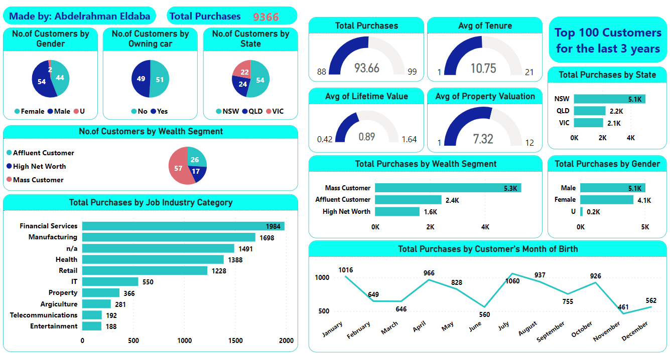
I have designed a Power BI report to display some insights about the top 100 customers. This is an image for it

Slide 5
Model Development
I built a Linear Regression model to predict the Lifetime Value for the customers in the full dataset not only for the top 100 customers.
I first made EDA to explore the dataset and find its features by displaying some visualizations.
After that, I made data preprocessing to prepare the data for the model as I removed unnecessary columns, encoded categorical variables and split the data.
You can look at it on my GitHub:
Abdelrahman47-code/KPMG-Internship (github.com)

Slide 6
Interpretation
The model gets quite good performance as it predicts the Lifetime Value by entering the other features.
The model results may be not the best, but it’s a starting step for making new changes.
I also made a dynamic dashboard where the user can select the values of inputs and then clicks on the Predict button to get the result.

Slide 7
Conclusion
Exploring the datasets and trying to find effective solutions is a challenging task. I did that work so that we can enhance the company sales to get new customers and keep the best customers.
I hope that be good work that can make the stakeholders get insights into customers’ history.
You will find the Power BI report and the Jupyter Notebook in the same folder of this file.
Thanks for giving me this opportunity and I will be happy if you approved it.

